Slide 1

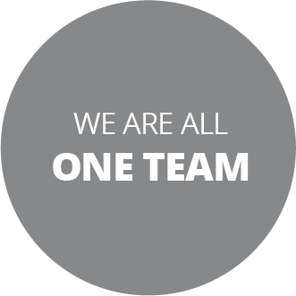

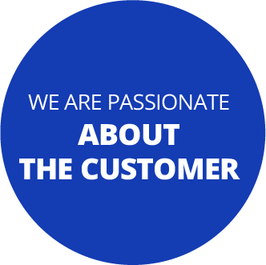

LET'S DISCUSS OUR RESULTS

Slide 2

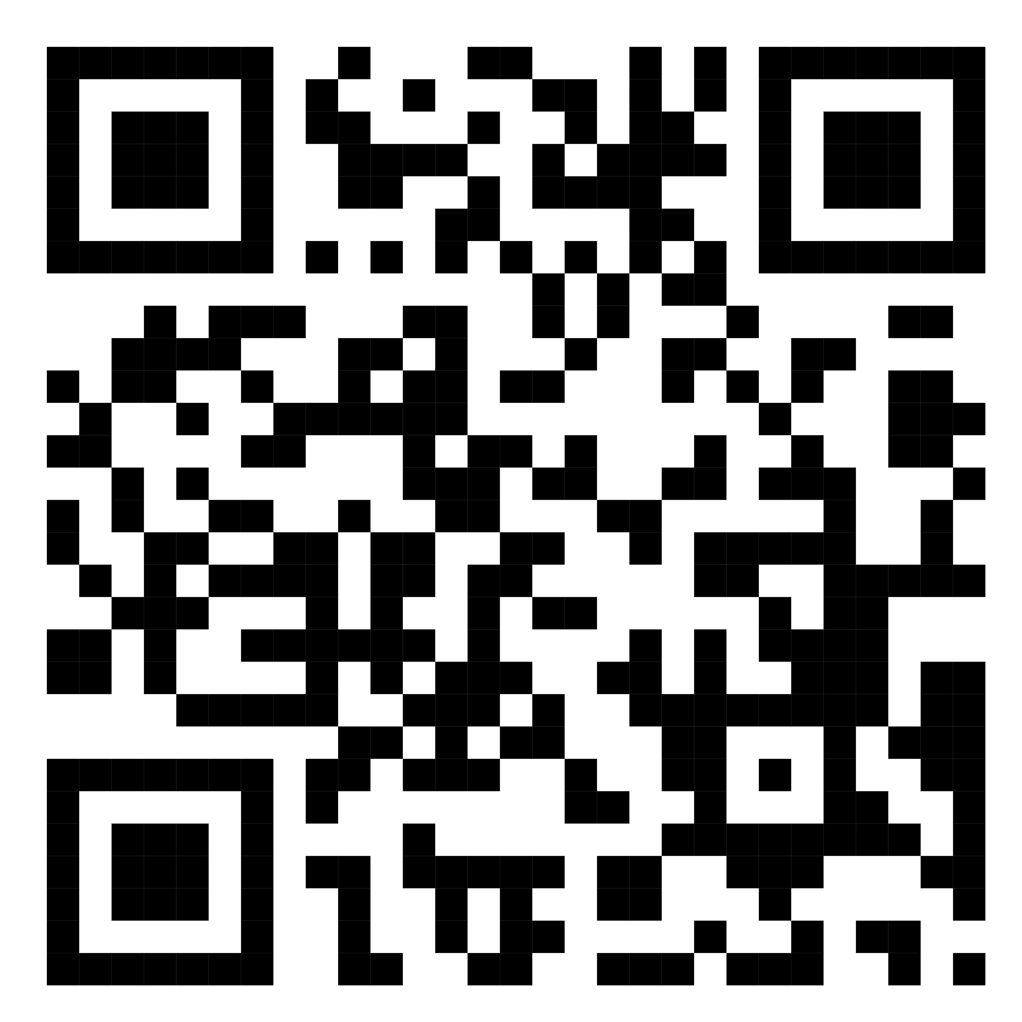
Download the infographic with the step-by-step guide to read, analyze, and work on the results of the Culture Survey with your team.

Slide 3
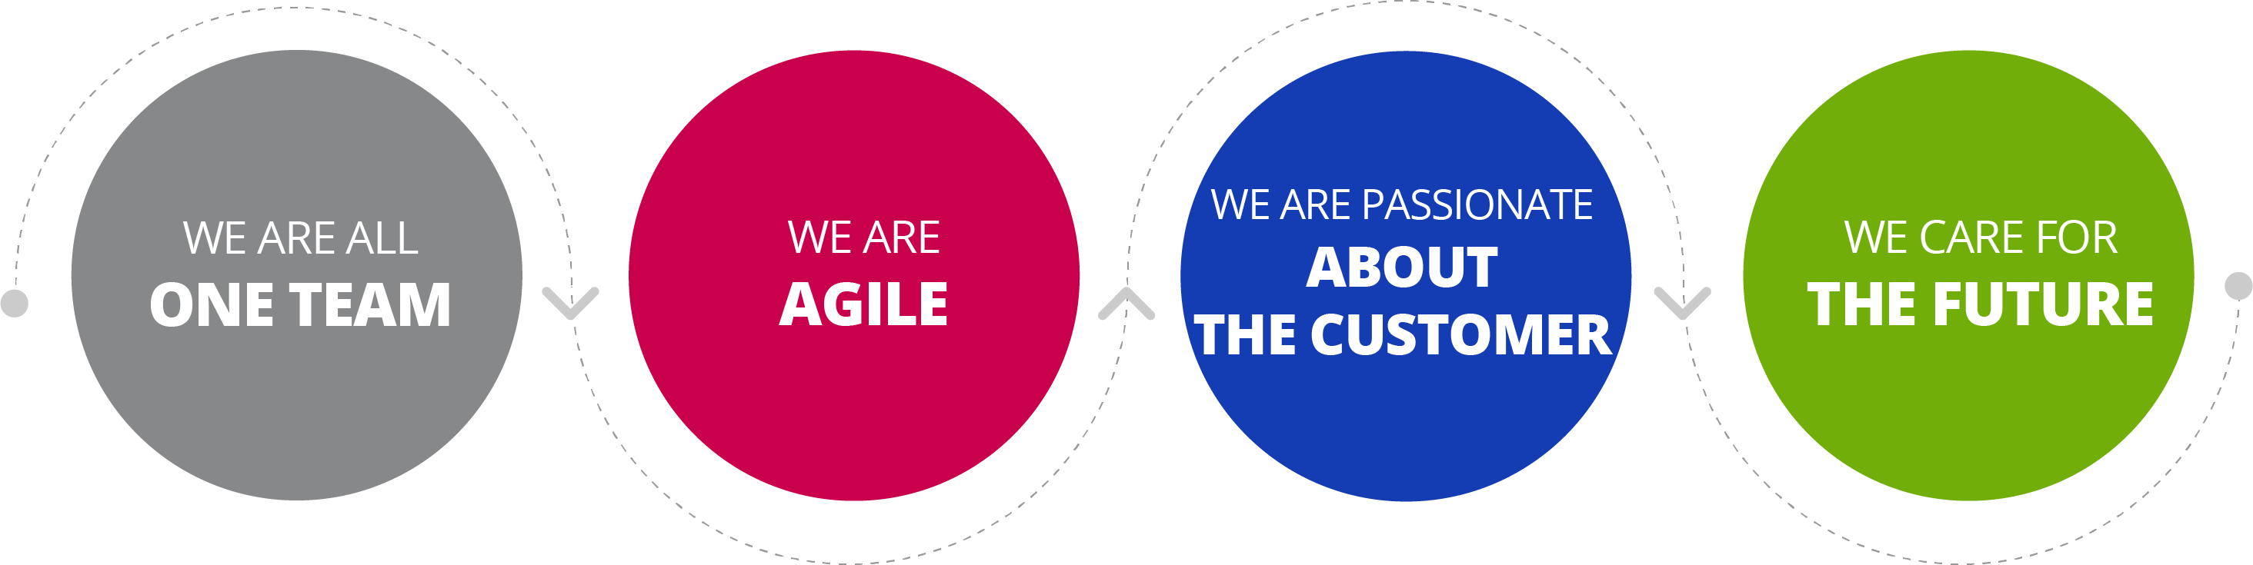
MEASUREMENT MODEL
THE SURVEY HAS TWO KEY ELEMENTS
PREDICTOR VARIABLES: SHARED VALUES (29)
The predictor variables correspond to elements that we can manage. Working on the action points mobilizes the outcome variables.
OUTCOME VARIABLES (4)
The outcome variables are a consequence of employees' experience and are not managed directly
eNPS
Likelihood to recommend the company as a workplace
Commitment to helping the company achieve its goals
Level of identification with the organization
How do our employees feel?
ENGAGEMENT
IDENTIFICATION
EMOTIONS
DIVERSE, TRUSTS, AND DEVELOPS PEOPLE
ANTICIPATING, TAKING THE LEAD, AND PERPETUAL LEARNING
WITH EMPATHY, KNOWLEDGE, AND SIMPLICITY
RESPECTING PEOPLE, SOCIETY, AND THE ENVIRONMENT
THESE VARIABLES ARE THE ONES THAT WE CAN ACTIVELY MANAGE AS A TEAM
.
THESE RESULTS ARE THE OUTCOME OF MANAGING THE VARIABLES ASSOCIATED WITH EACH VALUE

Slide 4

Key results for BU
Key results for BU
Key results for BU
Key results for BU
Key results for BU
Key results for BU
Key results for BU

Slide 5
KEY RESULTS FOR BU
MEASUREMENT SEPTEMBER-OCTOBER 2023
ENGAGEMENT
GOAL: 80%
eNPS
GOAL: 50 POINTS
EC 2022
%
EC 2022
%
EC 2022
%
xx%
xx%
xxPts.
PARTICIPATION
BU
ENGAGEMENT OR
COMMITMENT OF
THE BU
eNPS
OF THE BU
It is the degree of commitment that employees feel to help the company achieve its goals (pride, motivation to go above and beyond, intention to stay, and personal fulfillment).
The Employee Net Promoter Score (eNPS) score represents how likely employees are to recommend working at the organization. It is calculated by subtracting the percentage of detractors from the percentage of promoters.

Slide 6
KEY RESULTS FOR BU
MEASUREMENT SEPTEMBER-OCTOBER 2023
EMOTIONS
GOAL: 40% ENTHUSIASTIC INDIVIDUALS
EC 2022
%
EC 2022
%
EC 2022
%
EC 2022
%
xx%
xx%
xx%
xx%
WE FEEL
ENTHUSIASTIC
WE FEEL
PEACEFUL
WE FEEL
NERVOUS
WE FEEL
DISAPPOINTED
% of individuals who indicated one of the following emotions (enthusiasm, tranquility, nervousness, or disappointment) as the predominant one in their work over the last month.

Slide 7
KEY RESULTS FOR BU
MEASUREMENT SEPTEMBER-OCTOBER 2023
EC 2022
%
EC 2022
%
XX%
XX%
WE FEEL IDENTIFIED
WITH THE BU
WE FEEL IDENTIFIED WITH
THE FALABELLA GROUP
It corresponds to the degree to which employees identify with the organization. To be #AllOneTeam, identification with the Falabella Group should be as high as identification with the business.

Slide 8
KEY RESULTS FORMAT/MANAGEMENT
MEASUREMENT SEPTEMBER-OCTOBER 2023
ENGAGEMENT
eNPS
GOAL 80%
GOAL 50 pts.
REGIONAL AVERAGE
REGIONAL AVERAGE
NATIONAL AVERAGE
NATIONAL AVERAGE
IDENTIFICATION
EMOTIONS
GOAL
40% OF ENTHUSIASTIC INDIVIDUALS
REGIONAL AVERAGE
NATIONAL AVERAGE

Slide 9
GENERAL OVERVIEW OF BU
MEASUREMENT SEPTEMBER-OCTOBER 2023
XX%
XX%
XX%
XX%
WE ARE ALL
ONE TEAM
WE ARE
AGILE
WE ARE PASSIONATE
ABOUT THE CUSTOMER
WE CARE FOR
THE FUTURE
% of favorability for each value, according to the average of the
questions associated with it.

Slide 10
PERCEPCIÓN VALORES FORMATO/GERENCIA
MEASUREMENT SEPTEMBER-OCTOBER 2023
WE ARE ALL ONE TEAM
WE ARE AGILE
WE ARE PASSIONATE ABOUT THE CUSTOMER
WE CARE FOR THE FUTURE

Slide 11
GENERAL OVERVIEW OF BU
MEASUREMENT SEPTEMBER-OCTOBER 2023
HIGHEST-RATED QUESTIONS at the BU level that represent cross-cutting strengths to leverage:
VALUE | STATEMENT | % FAVORABILIDAD

Slide 12
GENERAL OVERVIEW OF BU
MEASUREMENT SEPTEMBER-OCTOBER 2023
Statements that have seen the MOST IMPROVEMENT in their evaluation compared to 2022 and STRENGTHEN US as a team :
VALUE | STATEMENT | % EC 2022 | % EC 2023 | DIFFERENCE

Slide 13
GENERAL OVERVIEW OF BU
MEASUREMENT SEPTEMBER-OCTOBER 2023
LOWEST-RATED QUESTIONS at the BU level that represent cross-cutting strengths to leverage:
VALUE | STATEMENT | % FAVORABILITY

Slide 14
GENERAL OVERVIEW OF BU
MEASUREMENT SEPTEMBER-OCTOBER 2023
Statements that have seen THE MOST DECREASE in their evaluation compared to 2022, and that we need to UNDERSTAND AND WORK ON.
VALUE | STATEMENT | % EC 2022 | % EC 2023 | DIFFERENCE

Slide 15

Key team results X
Key teams results X
Key teams results X
Key teams results X
Key teams results X
Key teams results X
Key teams results X

Slide 16
MAIN TEAM RESULTS X
MEASUREMENT SEPTEMBER-OCTOBER 2023
EC 2022
%
EC 2022
%
EC 2022
%
xx%
xx%
xx%
PARTICIPATION
BU
ENGAGEMENT
OR ENGAGEMENT
OF THE BU
eNPS
OF THE BU
It is the degree of commitment that employees feel to help the company achieve its goals (pride, motivation to go beyond, intention to stay, and personal fulfillment)
The Employee Net Promoter Score (eNPS) score represents how likely employees are to recommend working at the organization. It is calculated by subtracting the percentage of detractors from the percentage of promoters.

Slide 17
MAIN TEAM RESULTS X
MEASUREMENT SEPTEMBER-OCTOBER 2023
EC 2022
%
EC 2022
%
EC 2022
%
EC 2022
%
xx%
xx%
xx%
xx%
WE FEEL
ENTHUSIASTIC
WE FEEL
PEACEFUL
WE FEEL
NERVOUS
WE FEEL
DISAPPOINTED
% of individuals who indicated one of the following emotions (enthusiasm, tranquility, nervousness, or disappointment) as the predominant one in their work over the last month.

Slide 18
MAIN TEAM RESULTS X
MEASUREMENT SEPTEMBER-OCTOBER 2023
EC 2022
%
EC 2022
%
XX%
XX%
WE FEEL
IDENTIFIED WITH
THE BU
WE FEEL
IDENTIFIED WITH THE
FALABELLA GROUP
It corresponds to the degree to which employees identify with the organization. To be #OneTeam, identification with the Falabella Group should be as high as identification with the business.

Slide 19
TEAM X OVERVIEW
MEASUREMENT SEPTEMBER-OCTOBER 2023
XX%
XX%
XX%
XX%
WE ARE
AGILE
WE ARE PASSIONATE
ABOUT THE CUSTOMER
WE CARE FOR
THE FUTURE
WE ARE ALL
ONE TEAM
% of favorability for each value, according to the average of the questions associated with it.

Slide 20
MAIN TEAM RESULTS X
MEASUREMENT SEPTEMBER-OCTOBER 2023
WE ARE ALL ONE TEAM
I feel confident to voice my opinion, even if it means disagreeing with others | % Favorability
My leaders show an interest in me as a person, not just as an employee | % Favorability
In my work environment, it's easy to communicate with leaders | % Favorability
In this company, opportunities for professional development are transparent and fair | % Favorability
I can access the training I need to do my job well in this company | % Favorability
In my work environment, my skills and talents are valued | % Favorability
Recognition is a common practice in my work environment | % Favorability
We give each other feedback constantly in my work environment. | % Favorability
In my team, we value diversity and the unique contribution of each member. Favorability | % Favorability
STATEMENTS
THAT COMPRISE IT

Slide 21
MAIN TEAM RESULTS X
MEASUREMENT SEPTEMBER-OCTOBER 2023
WE ARE AGILE
In this company, there are instances to share ideas or new ways of doing things. | % Favorability
In my team, we have space to experiment and learn from mistakes. | % Favorability
I understand how my work contributes to the achievement of the company's strategic objectives. | % Favorability
My leaders convey a clear vision of where the company is headed. | % Favorability
In my work environment, we receive relevant information in a timely manner. | % Favorability
Leaders trust that employees do a good job without having to supervise them all the time. | % Favorability
In this company, I have the opportunity to learn new things continuously. | % Favorability
STATEMENTS
THAT COMPRISE IT

Slide 22
MAIN TEAM RESULTS X
MEASUREMENT SEPTEMBER-OCTOBER 2023
WE ARE PASSIONATE ABOUT THE CUSTOMER
My leaders continuously motivate me to make decisions focusing on the needs of our customers. | % Favorability
In my work environment, we consider data or information to make decisions. | % Favorability
In the Falabella Group, we all work together as one team. | % Favorability
In my team, we prioritize initiatives based on the needs of our customers. | % Favorability
STATEMENTS
THAT COMPRISE IT

Slide 23
MAIN TEAM RESULTS X
MEASUREMENT SEPTEMBER-OCTOBER 2023
WE CARE FOR THE FUTURE
My job allows me to balance my personal and work life. | % Favorability
My work environment is psychologically and emotionally healthy. | % Favorability
The available benefits align with my needs and interests. | % Favorability
I consider that I receive a salary commensurate with the work I do. | % Favorability
The company takes measures to ensure that the physical workspaces are suitable for carrying out our functions. | % Favorability
People are treated fairly, regardless of their age, nationality, gender, or sexual orientation. | % Favorability
In my work environment, we have all the tools, programs, or equipment to do our job. | % Favorability
The words of the leaders align with their actions. | % Favorability
The leaders conduct the business in an honest and ethical manner. | % Favorability
STATEMENTS
THAT COMPRISE IT

Slide 24
TEAM X OVERVIEW
MEASUREMENT SEPTEMBER-OCTOBER 2023
TOP-RATED QUESTIONS by the team and strengths to enhance:
VALUE | STATEMENT | % FAVORABILITY

Slide 25
TEAM X OVERVIEW
MEASUREMENT SEPTEMBER-OCTOBER 2023
Statements that have seen the MOST INCREASE in their evaluation compared to 2022 and STRENGTHEN US as a team:
VALUE | STATEMENT | % EC 2022 | % EC 2023 | DIFFERENCE

Slide 26
TEAM X OVERVIEW
MEASUREMENT SEPTEMBER-OCTOBER 2023
Questions WORST RATED by the team and areas that are top priorities for improvement:
VALUE | STATEMENT | % FAVORABILITY

Slide 27
TEAM X OVERVIEW
MEASUREMENT SEPTEMBER-OCTOBER 2023
Statements that have seen the MOST DECREASE in their evaluation compared to 2022, and that we need to UNDERSTAND AND WORK ON.
VALUE | STATEMENT | % EC 2022 | % EC 2023 | Difference

Slide 28

TEAM X OVERVIEW
MEASUREMENT SEPTEMBER-OCTOBER 2023
How to co-create an action plan?
Let's define the value and priority statements.
Let's define actions for each priority. They should be specific, associated with a result, and with defined deadlines and responsible parties.
Let's systematize our action plan in Qualtrics so that we can track its progress.
Let's agree on monitoring mechanisms and allocate time in our meetings to assess progress.

Slide 29
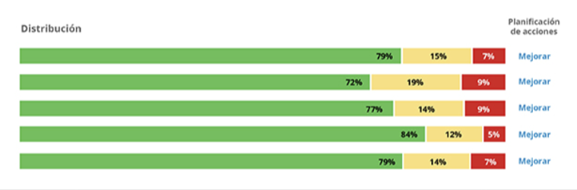
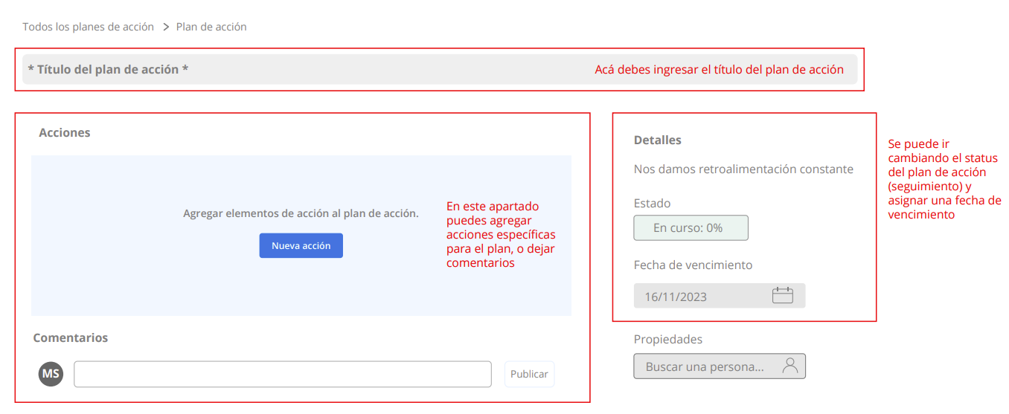
ACTION PLAN TEMPLATE QUALTRICS
1
"Search for the statement that the team identified as an improvement opportunity.
On the right side, click on "Improve," and then on "Create an action plan.”
Click on "View your action plan." A window will open where you will see the statement as the title. Change it to the name of the plan.
Review the "Actions" section and complete the information (steps, descriptions, deadlines, and responsible parties)
2
3
4

Slide 30
LET'S DISCUSS OUR RESULTS

